Slide 1
American Election 2016 Tweet Analysis
Simone Monti
Vittorio Maggio
GianMaria Balducci

Slide 2

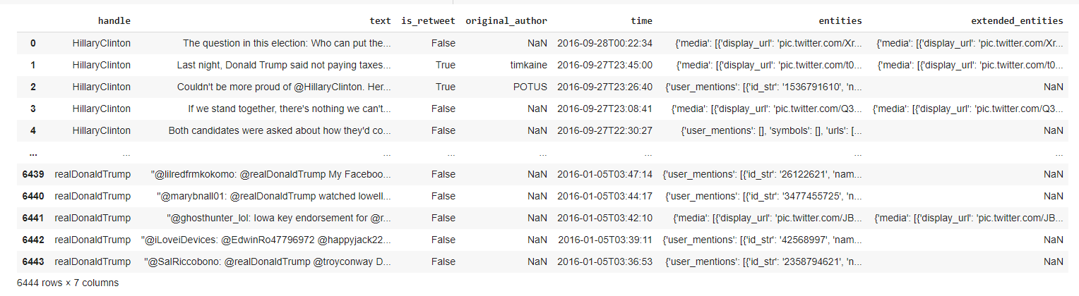
Starting Dataset
Trump: 3218
Clinton: 3226

Slide 3
Columns
Handle
Text
Is_retweet
Original_author
Time
Entities
Extended_entities

Slide 4
Steps
Named entity recognition and linking
01
Implementation of a polarity model
02
Tweets Analysis
03
WebApp
04

Slide 5

Named entity recognition and linking

Slide 6
Stages
Spotting
Candidate selection
Disambiguation

Slide 7
Spotting stage
Tokenization
Substring matching
Prefix tree
Aho-Corasick algorithm (LingPipe)

Slide 8
Candidate selection stage
Generation of candidates by traversing a finite state automaton encoding all possible sequences of tokens that form known spot candidates
OpenNLP
Selection of the best candidates
overlaps in the candidates are resolved based on a score and a preference-based choice: PER≻ORG≻LOC≻MISC≻NP≻MWU≻PP≻FSA lookup≻Capitalized Sequence.
Before seeing context – as a «default sense»
all candidates that fall below a specified score threshold are removed

Slide 9


Score – candidate selection
Based on wikilinks
Annotation probability (prior probability): $P(annotation|s) = \sum_{e}{count(e, s)/ count(s)}$
Sometimes bad performance (es: with acronyms)
$$e = entity$$
$$s =anchor text (spot)$$

Slide 10
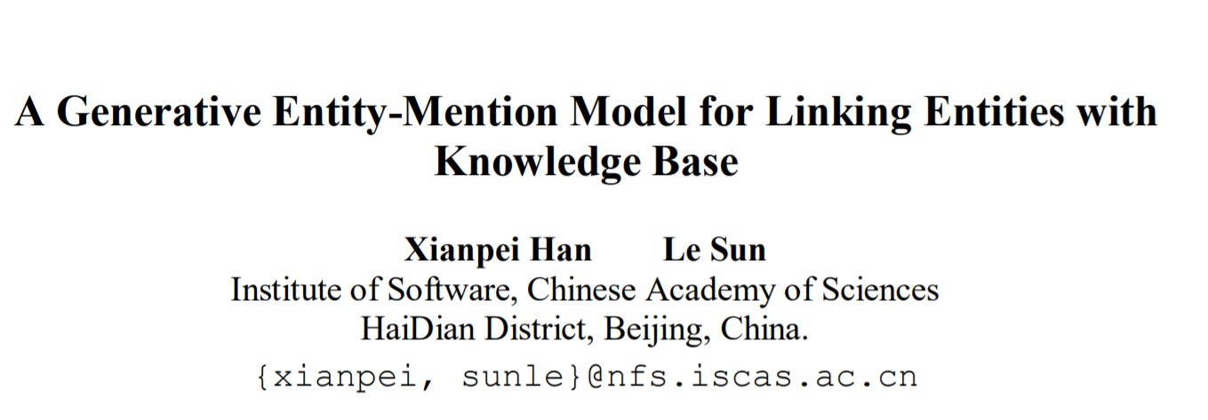
Disambiguation
https://www.aclweb.org/anthology/P11-1095.pdf

Slide 11

Disambiguation
Generative Probabilistic Model – Entity-mention Model
Wikipedia dataset:
$e →entity$
$s →phrase$
$c →context$
$M →$article links with their anchor texts and textual context

Slide 12
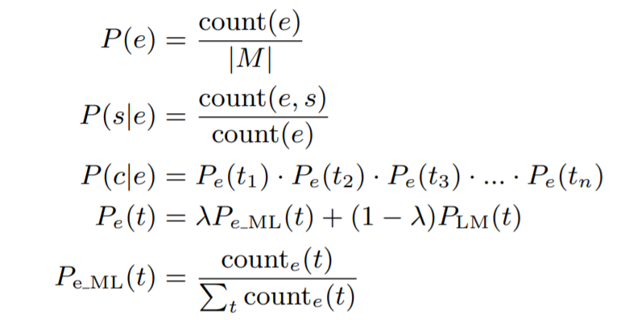
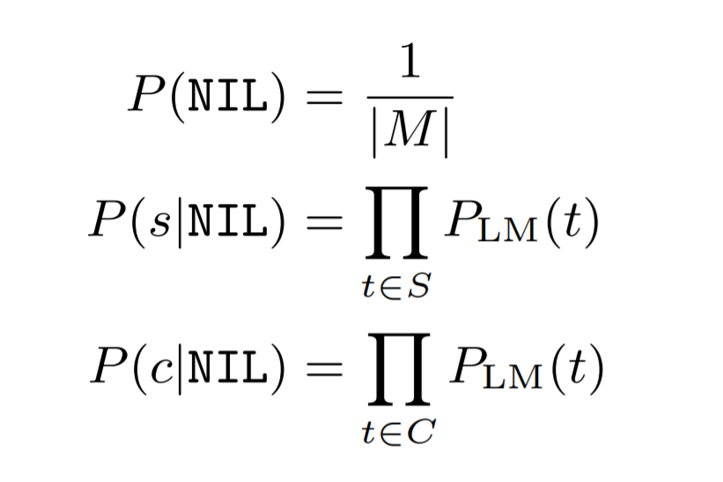


𝑃𝐿𝑀 → the smoothed general language model probability of a token that we estimate over all tokens imported to the system as context of an entity mention
The Jelinek-Mercer smoothing parameter λ = 0.2
$P_{LM}=P\left(e\right)∗P\left(s | e\right)∗P(c|e)$
The hypothesis that the context and phrase were not generated by any known entity - all entity candidates with a lower score than the NIL entity are removed
P(e) $→$ distribution of entities in document
P(s|e) $→$ the distribution of possible names of a specific entity
P(c|e) $→$the distribution of possible contexts of a specific entity.

Slide 13
Our configuration
Our confidence: 0.35
It will only annotate resources if the contextual ambiguity is less than (1−confidence)= 0.65
Given a confidence of 0.7, we get the topical pertinence threshold that 70% of the wrong test samples are below

Slide 14
Entity
Trump
Clinton
Tweet without entities: 9.88%
Different entities identified: 1856
Surface-form identified: 2094
Total entities: 7470
Tweet without entities: 12.43%
Different entities identified : 1718
Surface-form identified: 1901
Total entities: 6615

Slide 15
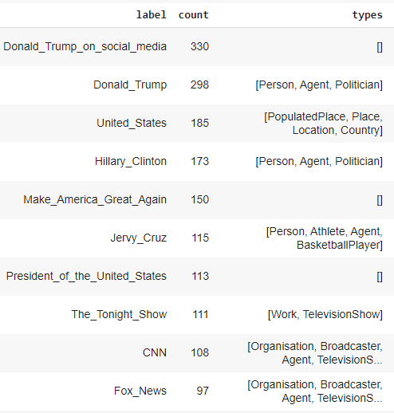
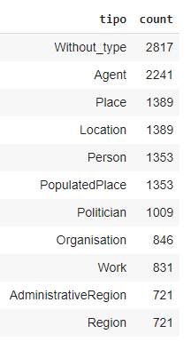
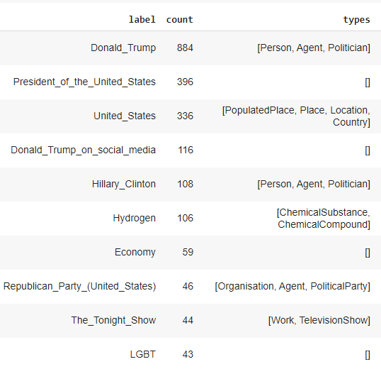
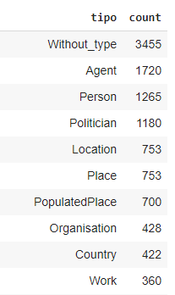
Most common entities/types
Trump
Clinton

Slide 16
Polarity

Slide 17
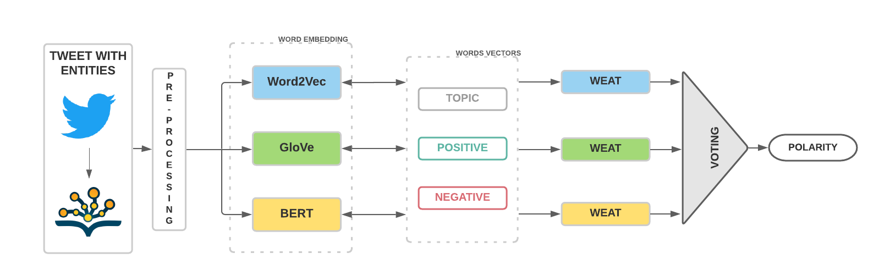
Polarity model

Slide 18
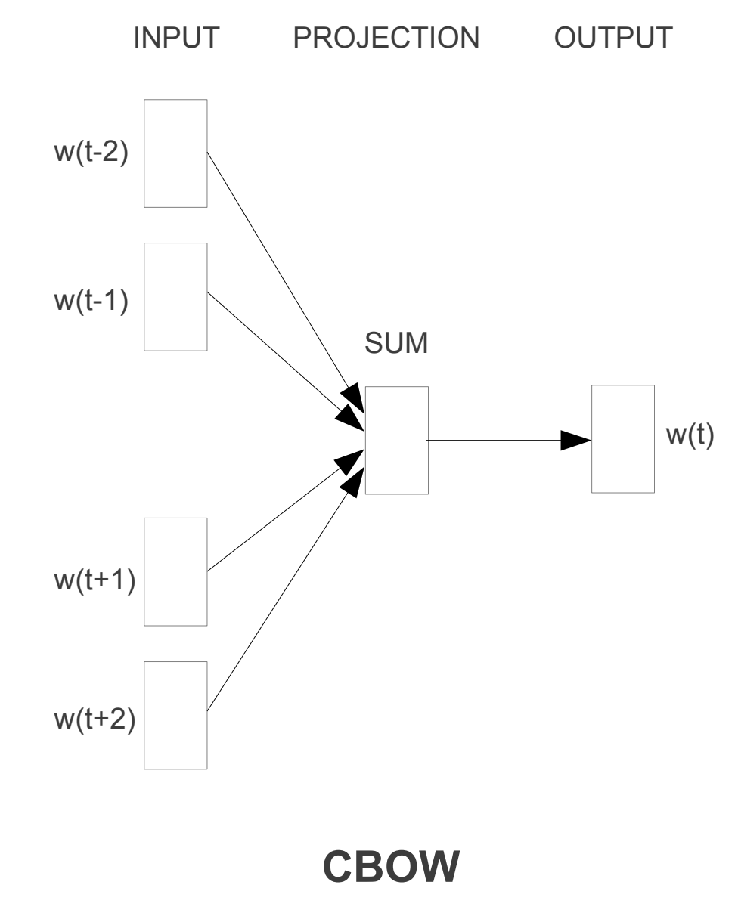

Word2Vec
Architecture: Continuos Bag-of-Words
Predict the current word based on the surrounding words (context words)
The objective function for CBOW is:
Window : 5

Slide 19
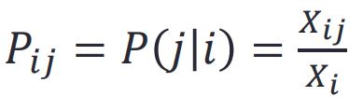
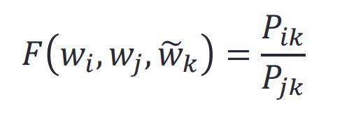
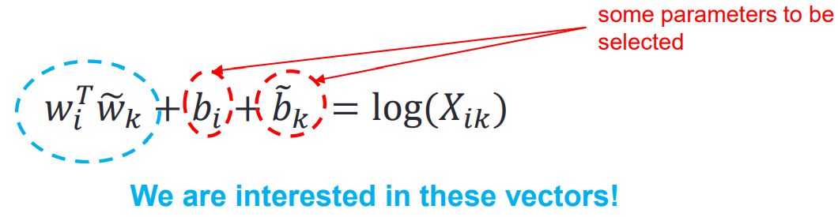
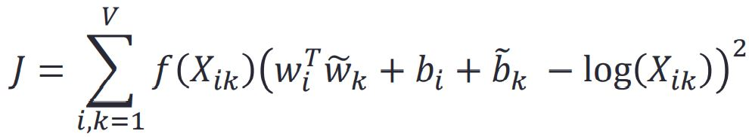

GloVe
Co-occurrence matrix X
Co-occurrence probabilities
Objective: construct a function
… after a series of steps, we obtain a simplification:
Then, GloVe builds an objective function J that associates word vector to text statistics:
(least squares problem)
(both capture similar co-occurrence information)

Slide 20
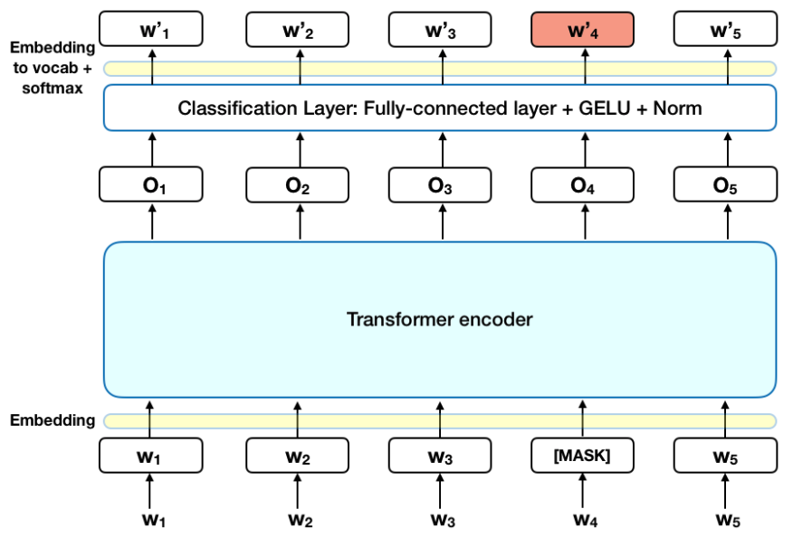
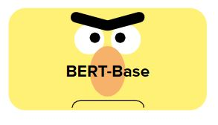
BERT (Bidirectional Encoder Representations from Transformers)
Tokenized Input: ['[CLS]’, 'I', '[MASK]', 'a', 'police', '##woman', '[SEP]’]
It learns contextual word representations:
the vector of a word changes with respect to the context
Pre-trained model:
Data: Wikipedia (2.5B words) + BookCorpus (800M words)
Batch Size: 131,072 words (1024 sequences * 128 length or 256 sequences * 512 length)
Optimizer: Adam, 1e-4 learning rate, linear decay
Architecture: 12-layer; 768-hidden-layer; 12-head

Slide 21


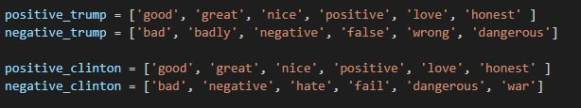

WEAT - Caliskan
Single target adaption:
W = topic, A = positive, B = negative

Slide 22
Analysis

Slide 23
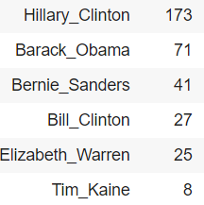
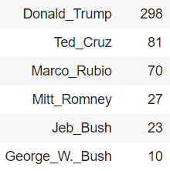
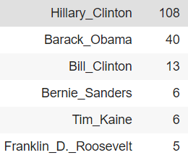
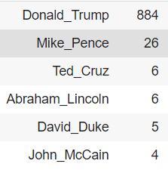
Who are the politicians most cited? What they think about them?
Trump
Clinton
Democratic
Republican
Democratic
Republican

Slide 24
Politician polarity
Leader | Party | W2V | Glove | Bert | Majority
Trump | Republican | -0.00394121 | 0.45970071 | 0.30018856 | +
 | Democratic | -0.00663326 | -0.39756773 | 0.11672534 | -
Clinton | Republican | -0.04819707 | 0.315081534 | 0.02750225 | +
 | Democratic | -0.047975619 | 0.280487134 | 0.18820126 | +

Slide 25
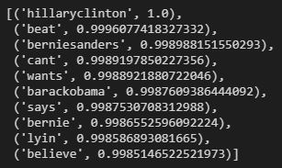
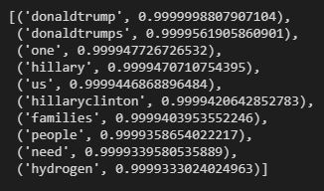
What do the leaders think of each other?
Trump
Clinton

Slide 26
Which are the non-american countries cited? What are the opinions?
China
Russia
Iraq
Iran

Slide 27
Trump – Entities used with countries
Iraq
Libya
Iran
Cash
China
Islamic_State_of_Iraq_and_Levant
Russia
Crimea
United States
Ex:
“Crooked Hillary just can't close the deal with Bernie. It will be the same way with ISIS, and China on trade, and Mexico at the border. Bad!”
“Crooked Hillary Clintons foreign interventions unleashed ISIS in Syria, Iraq and Libya. She is reckless and dangerous!”

Slide 28
Trump - Countries polarity
Country | W2V | Glove | Bert | Majority
China | -0.00437261 | 0.02320465 | -0.02463866 | -
Russia | -0.00377818 | 0.15094581 | -0.07769103 | -
Iraq | -0.00256812 | 0.15774842 | -0.00324684 | -
Iran | -0.00410711 | 0.04681618 | -0.00384347 | -

Slide 29
Clinton – Entities used with countries
Iraq
Family
Iran
Money laundering
China
Vietnam
Russia
Moscow Kremlin
Ex:
“Praying for a safe Eid Al-Fitr. My heart breaks for families struck by terror in Turkey, Iraq, Saudi Arabia, and Bangladesh this Ramadan. –H”
“How can you be tough on Iran, given your business partnership with someone connected to Iranian money laundering?”

Slide 30
Clinton - Countries polarity
Country | W2V | Glove | Bert | Majority
China | -0.05291671 | -0.01586804 | 0.00485769 | -
Russia | -0.04848618 | -0.20686781 | -0.00899924 | -
Iraq | -0.04357786 | -0.19340154 | -0.04021230 | -
Iran | -0.05132032 | 0.04703887 | -0.01632032 | -

Slide 31
Immigration
 | W2V | Glove | Bert | Majority
Trump | -0.00309141 | -0.48279724 | -0.063714448 | -
Clinton | -0.04695621 | -0.01348883 | -0.037578545 | -
Trump
Illegal immigration
Clinton
Deportation
Donald Trump

Slide 32
Media
Leader | Media cited | W2V | Glove | Bert | Majority
Trump | CNN, Fox News, The New York Times | -0.0040066 | 0.66897907 | 0.15018507 | +
Clinton | RT, The new York Times | -0.04782281 | -0.05068429 | 0.23628618 | -

Slide 33
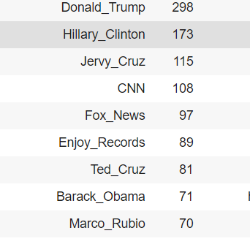
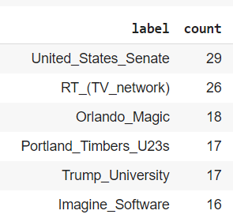
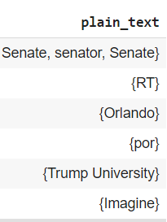
Limits
Confidence: 0.35 $→$Precision

Slide 34
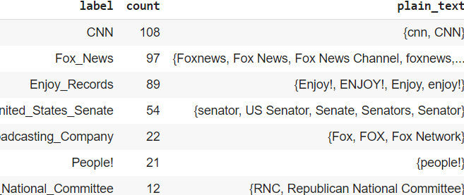

Slide 35
Future works
Expand the dataset with other tweets to improve the word embedding
Use different algorithms of NER and NEL
Use Cade to align the different embeddings and improve the analysis

Slide 36
References
Improving Efficiency and Accuracy in Multilingual Entity Extraction - Joachim Daiber, Max Jakob
DBpedia Spotlight: Shedding Light on the Web of Documents - Pablo N. Mendes, Max Jakob, Andrés García-Silva, Christian Bizer
A generative entity-mention model for linking entities with knowledge base - X. Han and L. Sun.
GloVe: Global Vectors for Word Representation - Jeffrey Pennington, Richard Socher, Christopher D. Manning
BERT: Pre-training of Deep Bidirectional Transformers for Language Understanding - Jacob Devlin, Ming-Wei Chang, Kenton Lee, Kristina Toutanova
Semantics derived automatically from language corpora contain human-like biases - Aylin Caliskan, Joanna J. Bryson, Arvind Narayanan

Slide 37
Thank you for your attention

